Slide 1
Pre-Requisites
AWS Free Tier Account
Software:
Docker
Libraries:
pep8
pep257
unittest2
pytest
bottle
cherrypy<9.0
Internet Connection

Slide 2
Basic Pillars of ML deployment

Slide 3
What is ML deployment?
Scalable inference on the cloud, in a timeframe that allows superior
user experience, while being cost-efficient.
MLOps is the new cutting edge skill.
Building AND deploying your own algorithm/models avoids “chinese whispers”

Slide 4
Trouble with Deploying ML
Why is this slow?
Why is this hogging all the CPU?
Where’s all the memory gone?
What’s with all these error messages?
Classic - “It works on my computer”
And many more ….

Slide 5
4 Pillars of ML Deployment
EXPLAINABILITY
Can I explain to stakeholders why my model is/isn’t working?
REUSABILITY
Can my codebase be reused for similar projects?
DEPLOYING ML PIPELINES
SCALABILITY
Does my code falter while processing volumes?
MAINTAINABILITY
How many people other than me can understand my code?

Slide 6
Reusability
Are their “duplications” in the codebase?
Is the code modular?
Are their redundant functions/variables ?
How many variables are hardcoded?
Are their too many heuristics involved?
Is there a configuration file to manage variables?
Are you reinventing the wheel?
Did you copy-paste that GH/SO code ?
Code reusability often separates the amateurs from the professionals.
Reusing code not only makes most sense when building a project, but it adds to the quality of your code. Building code for reusability often takes practice, but is easily achieved with some discipline while programming.
Notes:
DRY: https://www.artima.com/intv/dry.html
https://stackoverflow.com/questions/2490884/why-is-copy-and-paste-of-code-dangerous

Slide 7
Reusability - POP QUIZ 1
You need to create a logistic regression model on house prices, and you want to impress your boss. What do you do?
Recode LR from scratch in Numpy
Use Scikit for LR implementation, and work on feature engineering instead

Slide 8
Reusability - POP QUIZ 2
Which function is better written for reusability?
stopchars = [a, b, c, d]
def normalize_word(word):
word = word.strip().lower()
word = “”.join([char for char in word if char not in stopchars])
return word
stopchars = [a, b, c, d]
def normalize_word(word, stops=stopchars):
word = word.strip().lower()
word = “”.join([char for char in word if char not in stops])
return word

Slide 9
Maintainability
How many lines of code?
Are their “duplications” in the codebase?
Missing docstrings/code comments?
PEP8/PEP257 compliant?
Do my function names explain themselves?
Are their redundant functions/variables ?
Maintaining a codebase is part of the role for an ML Engineer.
What very few understand is that the technical debt and pain associated with refactoring a code could have been avoided with very simple methods early on.
Using tools like CodeClimate, PyCharm helps you avoid this trap.

Slide 10
Maintainability - POP QUIZ 3
What’s a better function name for a function that normalizes a word token?
preprocess_word
clean_word
process_token
process_string
normalize_word

Slide 11
Maintainability - POP QUIZ 4
Which function is better written?
def normalize_word(word):
return word.strip().lower()
def normalize_word(word):
“””Processes and returns a word, stripping whitespaces and lowercases it”””
return word.strip().lower()

Slide 12
Scalability
Scalability of a codebase means very different than the scalability of an application.
Many a times, a certain component of a codebase becomes a bottleneck, which slows the complete pipelines. Writing scalable code often requires a good understanding of data structures and techniques like memoization
How many complex data structures in the codebase?
Is the code dependent on local environment variables ?
Is the code optimized for search ?
What’s the test coverage percentage?
Do the test cases include rarely encountered edge cases?
Does the code execute CPU or memory intensive tasks?
Has the code been optimized with data structures and algorithms?
Are you caching results ?
Have you profiled your functions?

Slide 13
Explainability
Explainability of your code and your ML are both important, and can be not-so-straightforward at times.
If you are using a non-linear model, explainability becomes very difficult. For decision trees, visualizing features importances give an insight on how to improve the models. Ex. LIME, ELI5
Do you understand the code’s behaviour?
How readable is your code?
Is your model linear/non-linear
Have your ML feature importances been mapped?
Are you using frameworks like ELI5 or LIME?
Are your features independent?
Is your model training data well balanced?
Do you have knowledge of the environment variables that may affect predictions?
Notes:
https://www.data-imaginist.com/2017/announcing-lime/
https://arxiv.org/abs/1602.04938

Slide 14
Writing Production Grade code
S02

Slide 15
The Programmer from Hell
Variable names don’t make sense
No respect for indentation
Mixed up indentation
No comments for empirical/business logic steps
No docstrings
No usage examples
No test cases
PEP8/PEP257 non-compliant

Slide 16
Bad Code doesn’t mix well with prod
Maintenance issues
Technical Debt
Upgrades start breaking stuff
Backward compatibility is hit
Prod rollouts are delayed
Programming progress is hindered
Code base is polluted
No uniform standard in team

Slide 17
The philosophy
"A universal convention supplies all of maintainability, clarity, consistency, and a foundation for good programming habits too.
What it doesn't do is insist that you follow it against your will. That's Python!"
—Tim Peters on comp.lang.python, 2001-06-16
Notes:
If you violate these conventions, the worst you'll get is some dirty looks.

Slide 18
PEP8
Deals with how to style your python code. It defines the overall philosophy of structuring your code in an “easy-on-my-eyes” manner
3 Major Takeaways:
Naming Conventions
Code Comments
Code Styling
Notes:
https://www.python.org/dev/peps/pep-0008/

Slide 19
PEP8 - Naming Conventions
Function names should be lowercased, with words separated by underscores as necessary to improve readability
Class names should start with an upper case
Avoid reserved keywords as variables/function names
Never use single character variable names
For Constants, use all capital letters with underscores separating words
Avoid function/variable naming similar/same to libraries
Notes:
https://www.python.org/dev/peps/pep-0008/#naming-conventions

Slide 20
PEP8 - Code Comments
Comments should be complete sentences.
Block comments must have same indentation as the following code
Write docstrings(PEP257) for all public modules, functions, classes, and methods
Use inline comments sparingly, but must for business/empirical logic
Inline comments should be separated by at least two spaces from the statement
Notes:
https://www.python.org/dev/peps/pep-0008/#comments

Slide 21
PEP8 - Code Styling
Focus on the readability of the code - other team members must be able to understand your code properly
Use is not operator rather than not ... is
Prefer def statement than ad-hoc lambda statements
When catching exceptions, mention specific exceptions whenever possible instead of using a bare except
Object type comparisons should always use isinstance() instead of comparing types directly
Don't compare boolean values to True or False using ==, instead use if X
Notes:
https://www.python.org/dev/peps/pep-0008/#programming-recommendations

Slide 22
PEP257
Deals with docstring conventions, and help standardize docstring structures
DOCSTRING:
A docstring is a string literal that occurs as the first statement in a module, function, class, or method definition.
Notes:
https://www.python.org/dev/peps/pep-0257/

Slide 23
Broad strokes of PEP257
The docstring should summarize its behavior and document its arguments, return value(s), side effects, exceptions raised, and restrictions on when it can be called
Stick to triple quotes for single/multiline comments
No blank line either before or after the docstring
Multi-line docstrings consist of a summary line just like a one-line docstring, followed by a blank line, followed by a more elaborate description.

Slide 24
Staying Compliant
Use IDEs - continuous checking for format, redundancies, quick cleanups
Stick to one style of indentation (spaces OR tabs)
Use pylint to highlight issues
Use native PEP8/PEP257 packages to check for potential issues
Online tools to do a quick review of your code
In the end, focus on making sure that your code looks clean, not a hot mess

Slide 25
Tests for your code - WHY
Essentially assert statements
Check for code consistency and behaviour
Increasing code coverage reduce chances of future build failing
Writing unit tests while you are writing your code - recommended
Helps refine your codebase and improve quality
Debugging becomes faster
Instills better understanding of the code itself for the programmers

Slide 26
Tests - HOW
A testing unit should focus on one tiny bit of functionality and prove it correct
Each test unit must be fully independent. Each test must be able to run alone, and also within the test suite, regardless of the order that they are called
Tests should run fast and not rely on overtly complex setup/data structures
Always run the full test suite before a coding session, and run it again after
It is a good idea to implement a hook that runs all tests before pushing code to a shared repository - Ex. Travis CI
Use long and descriptive names for testing functions
Reference: http://docs.python-guide.org/en/latest/writing/tests/

Slide 27
Testing Frameworks
unittest is the batteries-included test module in the Python standard library
unittest2 is a backport of Python 2.7’s unittest module which has an improved API and better assertions over the one available in previous versions of Python
Pytest is a no-boilerplate alternative to Python’s standard unittest module
Unittest/2 is lot more extensible and mature, but requires a structured thinking to writing tests
You can also dynamically generate test cases - allows detection of edge cases pretty quickly

Slide 28
Hands on Tutorial 1
With a piece of provided code, refactor it & improve its PEP8/PEP257 standing
Suggest a list of tests to increase the code coverage
Code to be provided by the instructor

Slide 29
Hands on Tutorial 2
With your own code from a previous GreyAtom exercise, refactor it & improve its PEP8/PEP257 standing
Write a list of tests to increase the code coverage
Code to be provided by the instructor

Slide 30
Deploying ML
S03

Slide 31
Why Deploy your ML codebase
Open Source contribution
Earn creds
Company/Consulting project
Academic requirements

Slide 32
How to Deploy your ML codebase
Release as a PyPi package
Deploy on the cloud via ML products
Deploy as an API
Package the complete application as a Dockerfile

Slide 33
PyPi
The Python Package Index (PyPI) is a repository of software for the Python programming language
Over a 130K projects in the repository
Most popular way to distribute OSS
But, also home to many malicious software
WHEN
Kicking off an OSS in a specific use-case, with plans for future contributions from users.

Slide 34
Cloud Infrastructure
Services like AWS Sagemaker, Google ML, Azure ML
You upload the data, auto optimization and prediction via an API
Easier to manage versions and easy rollbacks
You pay per prediction
Becomes expensive over a long term
WHEN
You don’t have a lot of data scientists to iterate, limited knowledge of algorithms and scalability is a key

Slide 35
API
Deploy your ML model via Bottle/Flask
You upload the data, self optimize and expose prediction via an API
Tools like Postman, Locust to test the API’s outputs and load bearing capacity
You pay for the underlying computing resources
Non-scalable, yet perfect way to test a new model with domain experts
WHEN
You are building a demo or a sandbox to test a hypothesis for a limited set of users

Slide 36
Docker
Deploy your ML model but packaged with Docker
You upload the data, self optimize and expose prediction via an Docker entrypoint
Tools like AWS ECR, ECS, Kubernetes allow you to manage scaling easily
You pay for the underlying computing resources
Highly scalable, and best method to deploy ML in production
WHEN
You are rolling out your ML codebase for a wider audience

Slide 37
Docker
S04

Slide 38
What are containers
“Lightweight VMs” - But is it really?
Not virtual machines, but app-delivery model mechanism
“In a VM-centered world, the unit of abstraction is a monolithic VM that stores not only application code, but often the stateful data. A VM takes everything that used to sit on a physical server and just packs it into a single binary so it can be moved around. But it is still the same thing.
With Docker containers the abstraction is the application; or more accurately a service that helps to make up the application.“

Slide 39

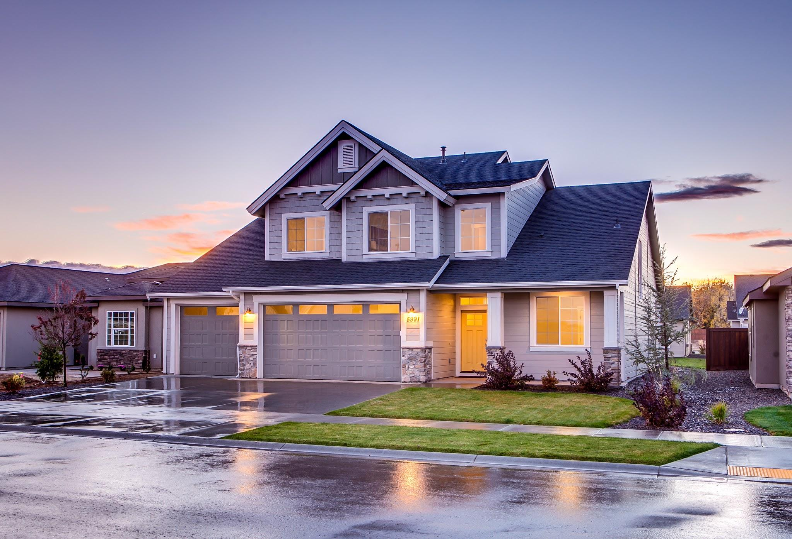
Docker vs VM

Slide 40
Before Docker
Setting up application environment was messy
“It works on my machine” - Really?
Application rollout was difficult and long winded
Replicability was not the primary concern
Scaling applications required a host of developers
Too many moving parts while working with VMs
CI/CD was clunky and non-reliable

Slide 41
Why Docker
As Martin Fowler puts it, Continuous Delivery is a software development discipline where you build software in such a way that the software can be released to production at any time.
You actually do continuous delivery if:
Your software is deployable throughout its lifecycle.
Your team prioritizes keeping the software deployable over working on new features.
Anybody can get fast, automated feedback on the production readiness of their systems any time somebody makes a change to them.
You can perform push-button deployments of any version of the software to any environment on demand

Slide 42
Development with Docker
Create requirements for an application within a Dockerfile or use Docker as a remote interpreter
Push the code up to git repo
A CI system builds the same environment that used in development to run the tests in prod
Roll out the exact configuration used in dev, testing and staging before prod
Be happy

Slide 43
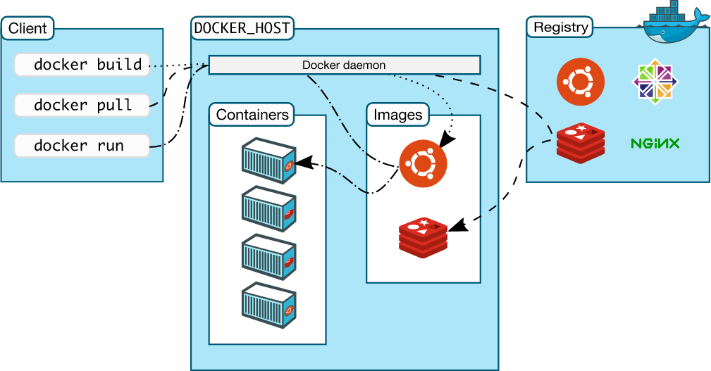
Brief Overview: Docker Architecture
Notes:
https://docs.docker.com/engine/docker-overview/#docker-architecture

Slide 44
Docker Terminology
CONTAINER:
A container is a runtime instance of a docker image.
A Docker container consists of
A Docker image
An execution environment
A standard set of instructions
The concept is borrowed from Shipping Containers, which define a standard to ship goods globally. Docker defines a standard to ship software.
Notes:
https://docs.docker.com/glossary/

Slide 45
Docker Terminology
BASE IMAGE:
An image that is built upon with systematic filesystem changes to build the final image
LAYERS:
Layers are applied in sequence to the base image to create the final image. When an image is updated or rebuilt, only layers that change need to be updated, and unchanged layers are cached locally. This is part of why Docker images are so fast and lightweight. The sizes of each layer add up to equal the size of the final image.
IMAGE
Docker images are the basis of containers. An Image is an ordered collection of root filesystem changes (layers) and the corresponding execution parameters for use within a container runtime. An image does not have state and it never changes unless rebuilt.
Notes:
https://docs.docker.com/glossary/

Slide 46
Docker Commands
docker build :
Build a docker image from a Dockerfile
docker run:
Run a docker container with some specified variables
docker exec
Execute a command inside a running docker container
Notes:
https://docs.docker.com/engine/reference/commandline/docker/#child-commands

Slide 47
Docker Commands
docker rm
Remove one or more containers
docker ps
List all the containers
docker images
List all the docker images on the local machine
Notes:
https://docs.docker.com/engine/reference/commandline/docker/#child-commands

Slide 48
Docker File - Best practices
Understand “WHY” you are building the Docker image
Minimize the layers and dependencies
Sort installs and arguments to avoid duplicates
Use cache to speed up docker builds
Comment your Dockerfile to help understand steps
Avoid “sudo”
Use the best possible image from registry to minimize reinvention
Think ephemeral, minimalism is the key. Be a “Gangster”
Notes:
https://docs.docker.com/develop/develop-images/dockerfile_best-practices/#the-dockerfile-instructions
https://runnable.com/blog/9-common-dockerfile-mistakes

Slide 49
Docker File - Commands
FROM
Defines the base image
LABEL
Add metadata for your app
RUN
Build time command to add and configure layers
Notes:
https://docs.docker.com/develop/develop-images/dockerfile_best-practices/#the-dockerfile-instructions

Slide 50
Docker File - Commands
CMD
Command to run during runtime
EXPOSE
Specify open ports of the containers during runtime
ENV
Define path variables for the container during buildtime to use during runtime
Notes:
https://docs.docker.com/develop/develop-images/dockerfile_best-practices/#the-dockerfile-instructions

Slide 51
Docker File - Commands
ADD/COPY
Copy files from host during build time
WORKDIR
Specify working directory during build/runtime
ENTRYPOINT
Define default command for the docker container
Notes:
https://docs.docker.com/develop/develop-images/dockerfile_best-practices/#the-dockerfile-instructions

Slide 52
Hands-on Tutorial 1
WHAT WE WILL DO
Write a Dockerfile that installs PyTorch , Keras and TensorFlow
Copy files from local that contain a sample code to print Keras code version
Build the Docker image
Mount and map a local folder to a running Docker container
Use nano to modify a file to reflect locally
Stop the Docker container
Notes:
https://aws.amazon.com/sagemaker/faqs/

Slide 53
AWS
S05

Slide 54
Cloud Platforms
Infrastructure platforms that can be used on a pay per use
Leaders are AWS, MS Azure and Google Cloud
Enables the deployment of business critical applications in a scalable environment
OSI Model Layers 1-4 taken care of by the cloud providers
99.9% SLA, limited downtime and managed scalability
Allows ML developers fastrack their DevOps capabilities

Slide 55
AWS
AWS began offering its technology infrastructure platform in 2006
Offers all the top requirements to satisfy security and audit requirements
Recognized independent third-party attestations, reports and certifications
Global infrastructure (including Mumbai) for edge deployments
Resize and rescale your environment at a click of the button
Low cost executions based on events - AWS Lambda

Slide 56
AWS - S3
S3 is a simple storage service that offers software developers a highly-scalable, reliable, and low-latency data storage infrastructure at very low costs.
Amazon S3 is also designed to be highly flexible. Store any type and amount of data that you want; read the same piece of data a million times or only for emergency disaster recovery; build a simple FTP application, or a sophisticated web application such as the Amazon.com retail web site
Dropbox, Netflix were one of the previous clients of AWS S3
100 GB of data costs ~3 USD per month
Allows you to secure data both at rest and transit very easily
Three models of data storage - S3, S3-IA and Glacier
FAQS
Notes:
https://aws.amazon.com/s3/faqs/

Slide 57
AWS - S3
Amazon S3 Standard - Infrequent Access (Standard - IA) is an Amazon S3 storage class for data that is accessed less frequently, but requires rapid access when needed. A has a thinner front end that provides nine one-hundredths of a percent less availability than S3 Standard
Amazon Glacier stores data for as little as $0.004 per gigabyte per month. To keep costs low yet suitable for varying retrieval needs, Amazon Glacier provides three options for access to archives, from a few minutes to several hours. Some examples of archive uses cases include digital media archives, financial and healthcare records, raw genomic sequence data, long-term database backups, and data that must be retained for regulatory compliance.
Notes:
https://aws.amazon.com/s3/faqs/

Slide 58
AWS - EC2
Amazon Elastic Compute Cloud (Amazon EC2) is a web service that provides resizable compute capacity in the cloud. It is designed to make web-scale computing easier for developers.
Takes less than 5 minutes to spin up a server and get going
Horizontal + Vertical scaling handled with extreme ease
Charged per hour of instance usage
Prepackaged AMIs for deep learning, CV, NLP and Linux flavours
FAQS
Notes:
https://aws.amazon.com/ec2/faqs/

Slide 59
AWS - ECR
Amazon Elastic Container Registry (ECR) is a fully-managed Docker container registry that makes it easy for developers to store, manage, and deploy Docker container images.
Amazon ECR uses Amazon S3 for storage to make your container images highly available & accessible
Amazon ECR transfers your container images over HTTPS and automatically encrypts images at rest
You can easily push your container images to Amazon ECR using the Docker CLI from your development machine, and Amazon ECS can pull them directly for production deployments.
FAQS

Slide 60
AWS - ECS
Amazon Elastic Container Service (ECS) is a highly scalable, high performance container management service that supports Docker containers and allows you to easily run applications on a managed cluster of Amazon EC2 instances.
Use containers as a building block for your applications by eliminating the need for you to install, operate, and scale your own cluster management infrastructure
Schedule long-running applications, services, and batch processes using Docker containers.
Amazon ECS maintains application availability and allows you to scale your containers up or down to meet your application's capacity requirements
Specify which container images are to be deployed, the CPU and memory requirements, the port mappings, and the container links
FAQS

Slide 61
AWS - Batch
AWS Batch manages compute environments and job queues, allowing you to easily run thousands of jobs of any scale using Amazon EC2
Supports any job that can executed as a Docker container. Jobs specify their memory requirements and number of vCPUs.
It avoids idling compute resources with frequent manual intervention and supervision.
Optimized for batch computing and applications that scale through the execution of multiple jobs in parallel
Deep learning, genomics analysis, financial risk models, Monte Carlo simulations, animation rendering, media transcoding, image processing, and engineering simulations are all excellent examples of batch computing applications.
Notes:
https://aws.amazon.com/batch/faqs/

Slide 62
AWS - Sagemaker
Amazon SageMaker is a fully-managed service that enables data scientists and developers to quickly and easily build, train, and deploy machine learning models
Jupyter notebooks are supported. You can persist your notebook files on an attached ML storage volume.
Amazon SageMaker includes built-in algorithms for linear regression, logistic regression, k-means clustering, PCA, factorization machines, neural topic modeling, LDA, gradient boosted trees, seq2seq, time series forecasting, word2vec, and CV. Amazon SageMaker supports your custom training algorithms provided through a Docker image adhering to the documented specification.
No fixed limits to the size of the dataset you can use for training models, you can specify the Amazon S3 location of your training data as part of creating a training job
Notes:
https://aws.amazon.com/sagemaker/faqs/

Slide 63
Hands-on Tutorial 1
WHAT WE WILL DO
Launching an EC2 instance on AWS
SSH into and and install packages on the server
Securing the server through security groups
Notes:
https://aws.amazon.com/sagemaker/faqs/

Slide 64
Hands-on Tutorial 2
WHAT WE WILL DO
Install Docker on EC2
Download data from S3
Upload data to S3
Securing objects on S3
Notes:
https://aws.amazon.com/sagemaker/faqs/

Slide 65
Hands-on Tutorial 3
WHAT WE WILL DO
Create an docker image on EC2
Push the docker image to ECR
Pull an image from ECR, update and re push the image
Notes:
https://aws.amazon.com/sagemaker/faqs/

